Slide 1
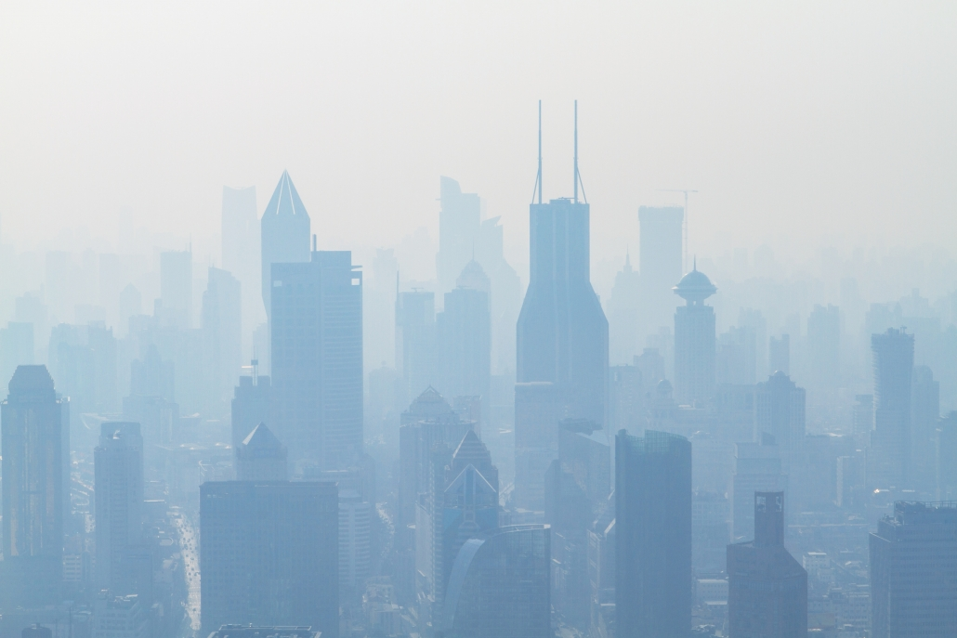
air Quality Prediction
JAHNAVI JAMMULA

Slide 2
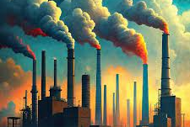
Agenda
Introduction
About Data set
Algorithm & its flow
Parameter tuning & Training
Summary

Slide 3
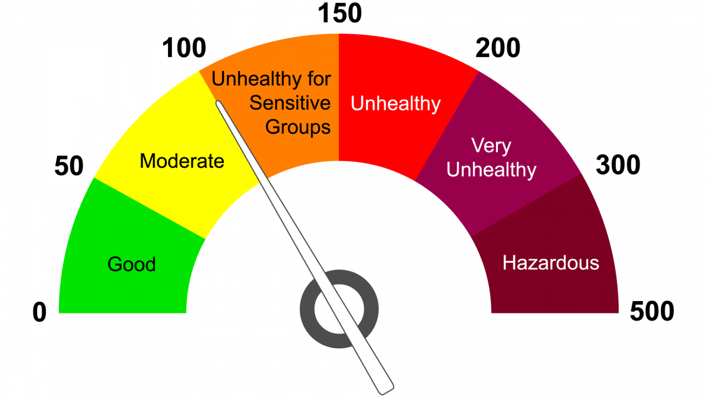
Introduction
Our goal in this study was to use machine learning techniques to estimate the air quality.
Dataset includes the daily pollution and Air quality Index(AQI) data for several different cities.
The dataset, “city_day.csv”, was retrieved from an accessible data source. The dataset include columns pertaining to several pollutants, including the AQI and AQI bucket for each day, as well as PM2.5, PM10, NO, NO2, CO, SO2,O3, Benzene, Toluene, and Xylene.

Slide 4
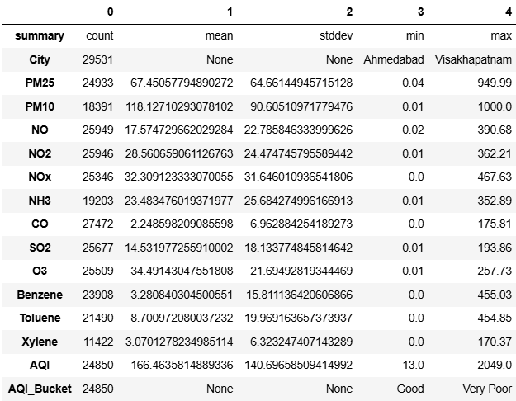
Explaining about the Dataset of Air Quality Prediction:
Particulate Matter (PM2.5 and PM10):
PM2.5 (fine particles) has an average concentration of 67.45 µg/m³ with a standard deviation of 64.66 µg/m³.
PM10 (coarse particles) has an average concentration of 118.13 µg/m³ with a standard deviation of 90.61 µg/m³.
Nitrogen Compounds:
NO (Nitric Oxide) has an average concentration of 17.57 ppb with a standard deviation of 22.79 ppb.
NO2 (Nitrogen Dioxide) has an average concentration of 28.56 ppb with a standard deviation of 24.47 ppb.
NOx (Total Nitrogen Oxides) has an average concentration of 32.31 ppb with a standard deviation of 31.65 ppb.
Other Pollutants:
NH3 (Ammonia) has an average concentration of 23.48 µg/m³ with a standard deviation of 25.68 µg/m³.
CO (Carbon Monoxide) has an average concentration of 2.25 ppm with a standard deviation of 6.96 ppm.
SO2 (Sulfur Dioxide) has an average concentration of 14.53 ppb with a standard deviation of 18.13 ppb.
O3 (Ozone) has an average concentration of 34.49 ppb with a standard deviation of 21.69 ppb.
Benzene has an average concentration of 3.28 µg/m³ with a standard deviation of 15.81 µg/m³.
Toluene has an average concentration of 8.70 µg/m³ with a standard deviation of 19.97 µg/m³.
Xylene has an average concentration of 3.07 µg/m³ with a standard deviation of 6.32 µg/m³.
Air Quality Index (AQI):
The overall AQI has an average value of 166.46, ranging from a minimum of 13 to a maximum of 2049.
The AQI categories vary from Good to Very Poor.
Remember that lower pollutant concentrations and better AQI values are desirable for health and well-being.
Take necessary precautions based on local air quality levels to protect yourself and the environment!

Slide 5
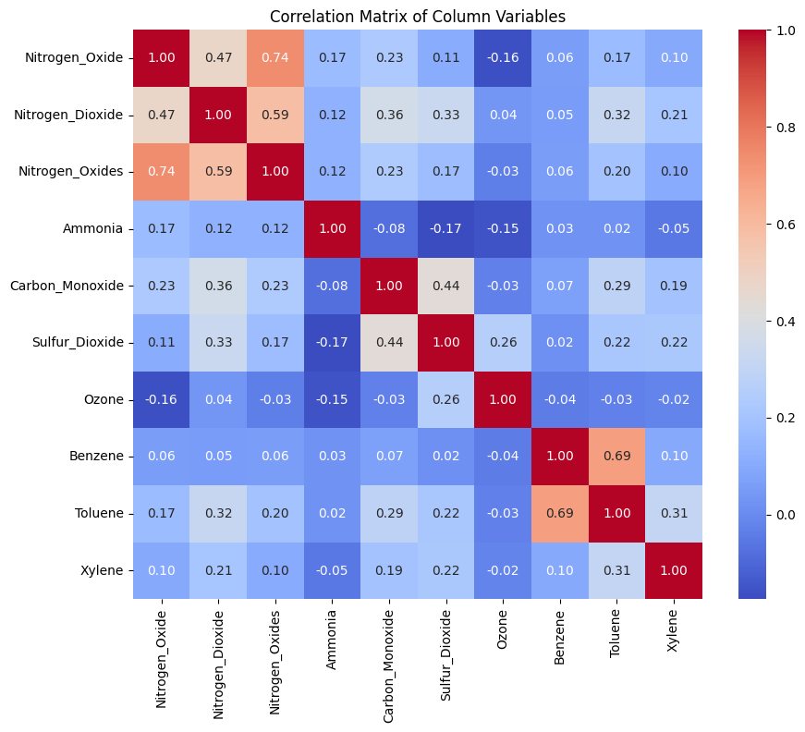
correlation
Nitrogen Oxide (NO) has a strong positive correlation with Nitrogen Oxides (NOx), which is expected as NOx includes NO. It has a moderate positive correlation with Nitrogen Dioxide (NO2)
Nitrogen Dioxide (NO2) shows a moderate positive correlation with Carbon Monoxide (CO) and Sulfur Dioxide (SO2), indicating that they might share common sources or conditions that favor their presence.
Ammonia (NH3) shows very little to no correlation with most pollutants, suggesting it has different sources or behaviors in the atmosphere.
Carbon Monoxide (CO) has a strong positive correlation with Sulfur Dioxide (SO2), which might indicate combustion processes as a common source.
Ozone (O3) shows a negative correlation with Nitrogen Oxide (NO) and Ammonia (NH3), which could be due to the chemical reactions in the atmosphere where NO and NH3 can act as ozone scavengers.
Volatile Organic Compounds (VOCs) like Benzene, Toluene, and Xylene show varying degrees of positive correlations with each other, especially Benzene and Toluene, which have a very strong positive correlation, indicating they may come from similar sources such as industrial processes or vehicle emissions.

Slide 6

algorithm & It’s goals

Slide 7
Algorithm approach flow
Understanding the Problem
AQI is a measure of air pollution that provides information on air quality and associated health risks
We’ll use environmental parameters (such as temperature, humidity, wind speed, PM2.5 and PM10 particulate matter concentration, ozone levels) to predict the AQI.
Data Preparation & Preprocessing
Load the air quality dataset (which includes relevant environmental parameters and AQI values).
Explore the dataset to understand its structure and features.
Random Forest is an ensemble learning technique that combines multiple decision trees to improve prediction accuracy.
Random Forest Algorithm
Hyperparameter Tuning
Tune hyperparameters (e.g., number of trees, maximum depth, minimum samples per leaf) using techniques like cross-validation.
Use grid search or random search to find optimal hyperparameters.
Model Training
Train the Random Forest model on the training data.
Model Evaluation
Evaluate the model using metrics such as mean absolute error (MAE), mean squared error (MSE), and root mean squared error (RMSE).
Use the testing subset to assess model performance.

Slide 8
Data preparation & Processing
"Filling missing values with the mean helps maintain the dataset's statistical properties."
"This approach is particularly useful when missing data is randomly distributed."
"However, it's essential to consider the impact on data distribution and model performance.“
"Using PySpark's VectorAssembler, we consolidate the selected features into a single vector."
"The selected features are transformed into a feature vector, which is essential for machine learning algorithms."
"This step prepares our data for model training by organizing the features into a format suitable for analysis."
"Through feature selection and assembly, we streamline the data for predictive modeling tasks."
"The assembled dataset is now ready for training and evaluation, setting the stage for building robust machine learning models."

Slide 9
Data preparation & Processing
"Split data into train and test sets":
"In machine learning, it's essential to split our dataset into separate sets for training and evaluation."
"Here, we randomly split the assembled dataset into training and testing subsets."
"80% of the data is allocated for training, while 20% is reserved for testing."
"The 'seed' parameter ensures reproducibility by fixing the random seed for the split."
"train_data, test_data = assembled_data.randomSplit([0.8, 0.2], seed=123)":
"We assign the training and testing datasets obtained from the random split to variables 'train_data' and 'test_data' respectively."
"The 'randomSplit' function divides the 'assembled_data' into two subsets based on the provided ratios."
"Drop rows with null or NaN values in the target column":
"To ensure accurate evaluation, we remove any instances with missing values in the target column."
"Dropping rows with null or NaN values helps maintain the integrity of our evaluation process."

Slide 10
Understanding ML implementation
"data = train_data.dropna(subset=[target_column])":
"We create a new DataFrame 'data' by dropping rows with missing values in the target column from the training dataset."
"This ensures that our model training is conducted on clean, complete data."
"# Train RandomForestRegressor model":
"Now, we're ready to train our machine learning model using the RandomForestRegressor algorithm."
"RandomForestRegressor is an ensemble learning method that fits multiple decision trees on different subsets of the dataset."
"rf = RandomForestRegressor(featuresCol="features", labelCol=target_column)":
"We initialize the RandomForestRegressor model, specifying the input features column ('features') and the target column."
"model = rf.fit(data)":
"The model is trained on the 'data' DataFrame using the 'fit' method."
"During training, the model learns to predict the target variable based on the input features."
"datat = test_data.dropna(subset=[target_column])":
"Similar to the training set, we remove rows with missing target values from the testing dataset to ensure fair evaluation."
"predictions_var = model.transform(datat)":
"Finally, we use the trained model to make predictions on the test dataset."
"The 'transform' method applies the trained model to the test data, generating predictions for the target variable."

Slide 11
Hyper parameter tuning
"Import necessary functions":
"We begin by importing the required functions from the 'pyspark.sql.functions' module."
"These functions enable us to perform operations on DataFrame columns, such as checking for null or NaN values."
"Filter rows with null or NaN values":
"We filter the training data ('train_data') to remove rows containing null or NaN values."
"Each line filters out rows with null or NaN values for a specific pollutant or air quality parameter."

Slide 12
Model training
"For example, the first line filters out rows with null or NaN values in the 'Ozone' column."
"cleaned_train_data = train_data.filter(~(isnan(col("Ozone")) | col("Ozone").isNull()))":
"The filtered DataFrame is assigned to 'cleaned_train_data'."
"Train RandomForestRegressor model with hyperparameter tuning":
"Once the data is cleaned, we proceed to train the RandomForestRegressor model."
"In this case, the model training involves hyperparameter tuning, which optimizes the model's performance."
"The trained model is stored in the variable 'model'."
"model = crossval.fit(cleaned_train_data)":
"Here, 'crossval' refers to the cross-validation object used for hyperparameter tuning."
"The 'fit' method is applied to the cleaned training data, triggering the training process with hyperparameter tuning."

Slide 13
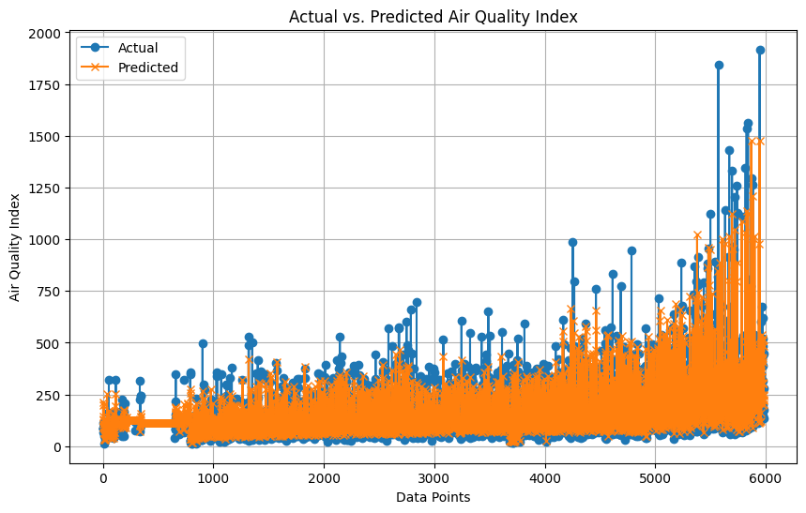
Combustion processes are likely a common source for several pollutants such as NO, NO2, CO, and SO2.
VOCs tend to correlate with each other, suggesting similar sources or atmospheric behaviors.
The negative correlations with Ozone suggest complex atmospheric chemistry and interactions with other pollutants.
Root Mean Squared Error (RMSE): 82.29571840334864

Slide 14

Areas of focus
Minimize car use: Avoid driving during rush hour and consider walking, biking, or using public transportation1.
Energy conservation: Turn off lights and electronics when not in use and use energy-efficient appliances1.
Renewable energy: Use renewable energy sources to power your home and for cooking1.
Waste management: Compost organic waste and recycle materials instead of burning them1.
Indoor air quality: Keep air-purifying plants, use natural cleaning products, and ensure proper ventilation in your home2.
Awareness: Check daily air pollution levels and stay informed about air quality to plan outdoor activities accordingly1.
Community involvement: Support policies and initiatives that aim to reduce emissions from industrial and vehicular sources2.

Slide 15


Thank you

